Slide 1



Microsoft Fabric
Sessão 2 Hora da Refeição
Armando Lacerda
Azure Cloud Architect Independent Consultant
Tiago Balabuch
Cloud Solutions Architect
Notes:
Both

Slide 2
Agenda
Lake-centric and open architecture
Data silos elimination
Demos

Slide 3








OneLake
Data Factory
Data Warehouse
Data Engineering
Data Science
Real Time Analytics
Data Activator
Power BI

Slide 4
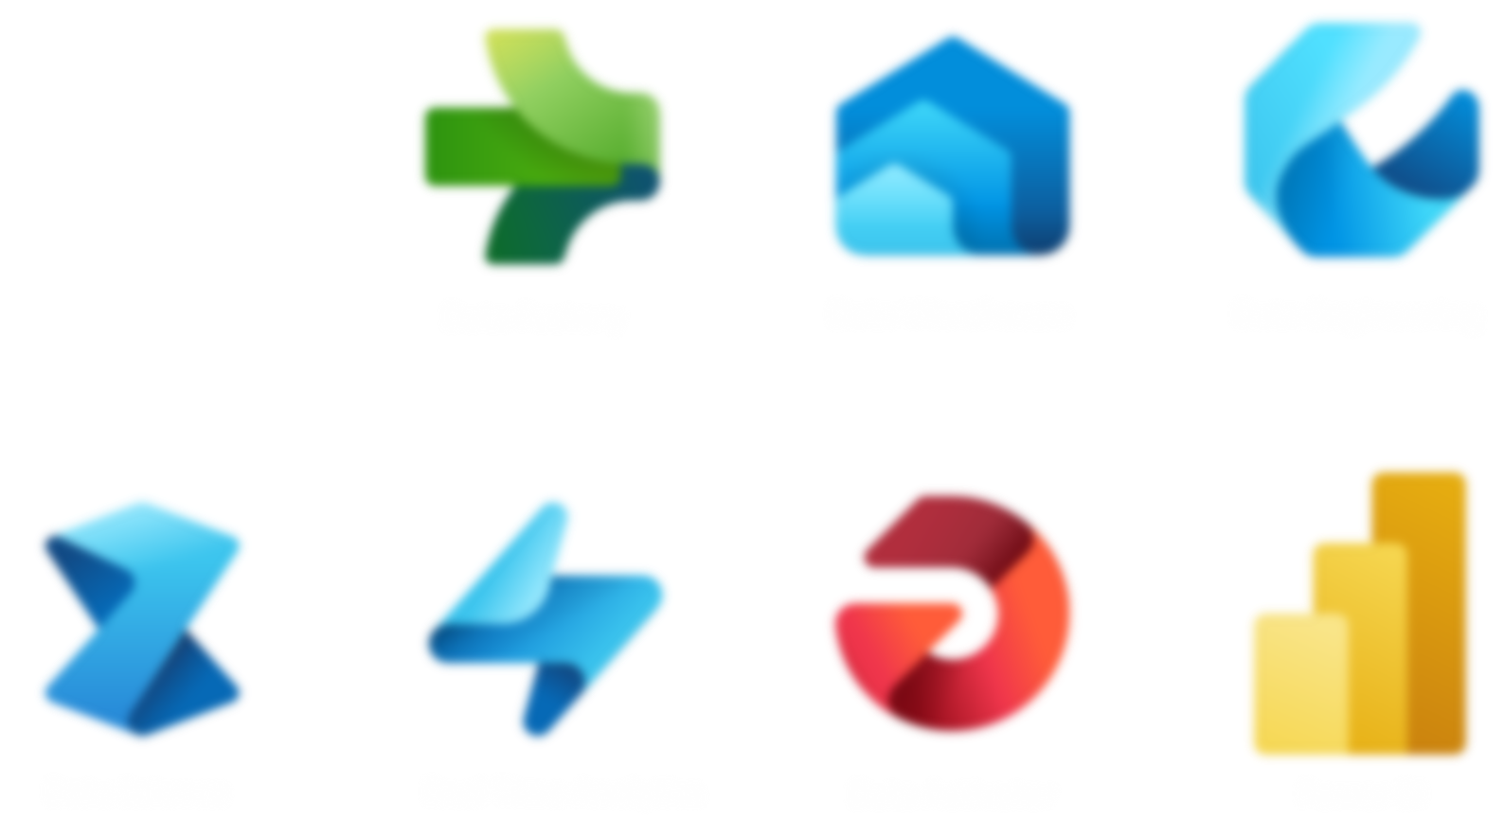
OneLake

Slide 5
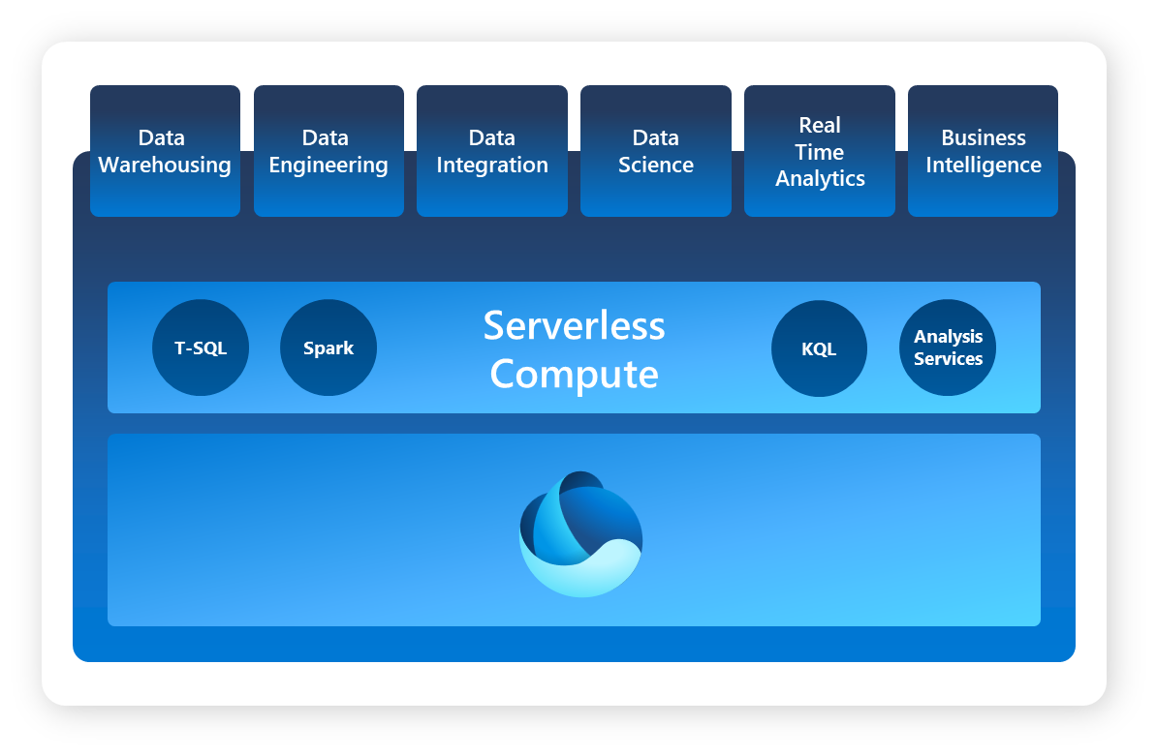

Slide 6
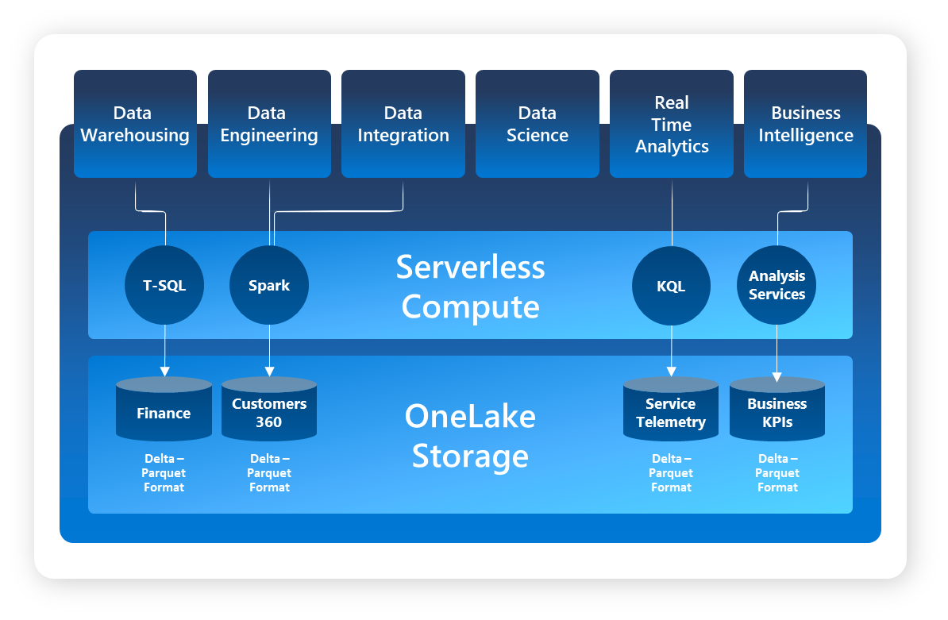

Slide 7
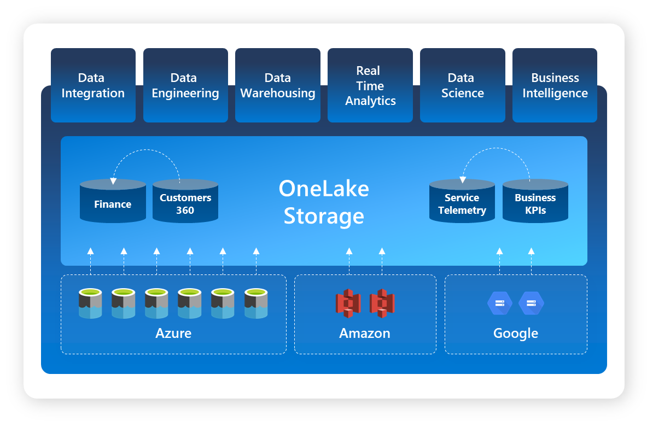

Slide 8
Demos

Slide 9
Nos vemos na próxima sessão.
Armando Lacerda
Azure Cloud Architect Independent Consultant
Tiago Balabuch
Cloud Solutions Architect
Notes:
Armando and Tiago

